Slide 1

MOBILE Clients
Channel Overview
Proprietary and Confidential - © Blitz Digital Studios, LLC.

Slide 2
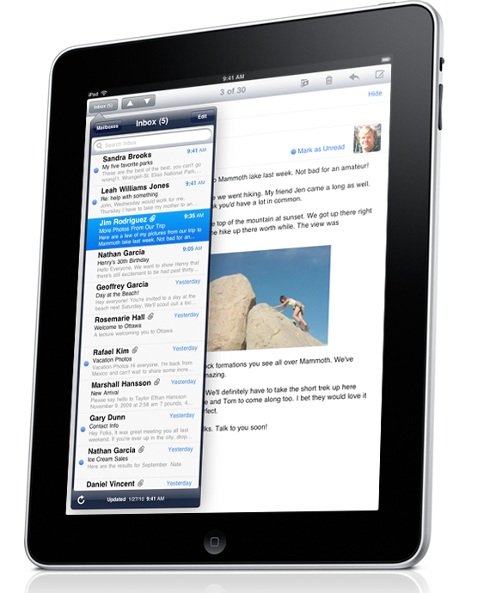
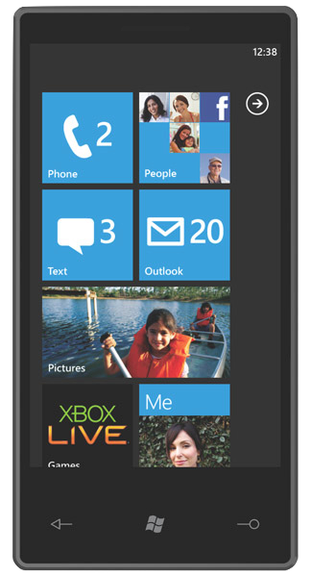

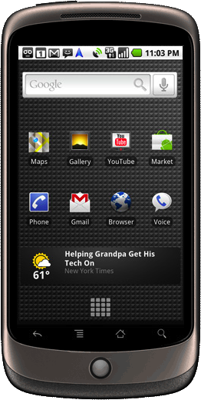

Channel Opportunity
A capable computer in your pocket
Mobile Operating Systems
  Business Oriented
    BlackBerry
  Consumer Oriented
    Android
    iPhone
    Symbian
    Windows Phone 7
Mobile apps have landed
  Native Applications
  Web Applications
  Games
  Flash Support
Information at the point of decision
Interaction in the real world
Proprietary and Confidential - © Blitz Digital Studios, LLC.

Slide 3
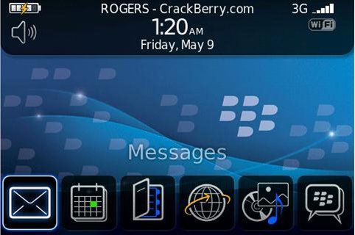
Mobile Operating Systems
Business Oriented OS
  BlackBerry
Can Perform Consumer Activities
Marketed Towards Businesses / Government
To be sure, Windows Phone 7 will also be targeted towards business users.
I feel it’s dominant market however, will be consumers.
Proprietary and Confidential - © Blitz Digital Studios, LLC.

Slide 4
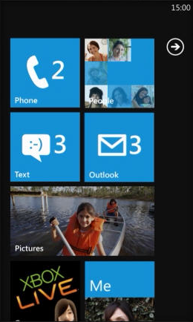
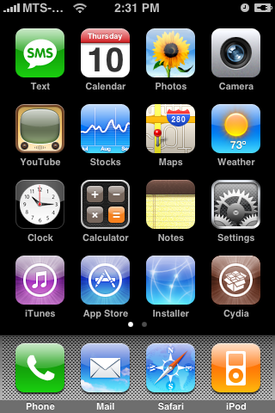
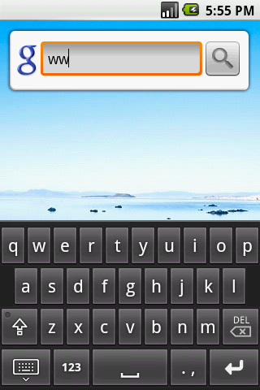
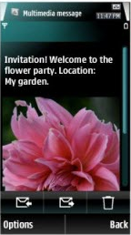
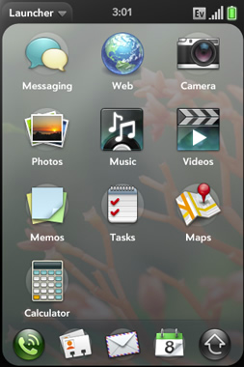
Mobile Operating Systems
Consumer Oriented OS
  Android
  iPhone
  WebOS
  Windows Phone 7
Can Perform Business Functions
Marketed as Consumer Devices
Proprietary and Confidential - © Blitz Digital Studios, LLC.

Slide 5
Mobile Apps Have Landed
Four Flavors of Mobile Applications
  Native Applications
  Web Applications
  Games
  Flash Support
Proprietary and Confidential - © Blitz Digital Studios, LLC.

Slide 6
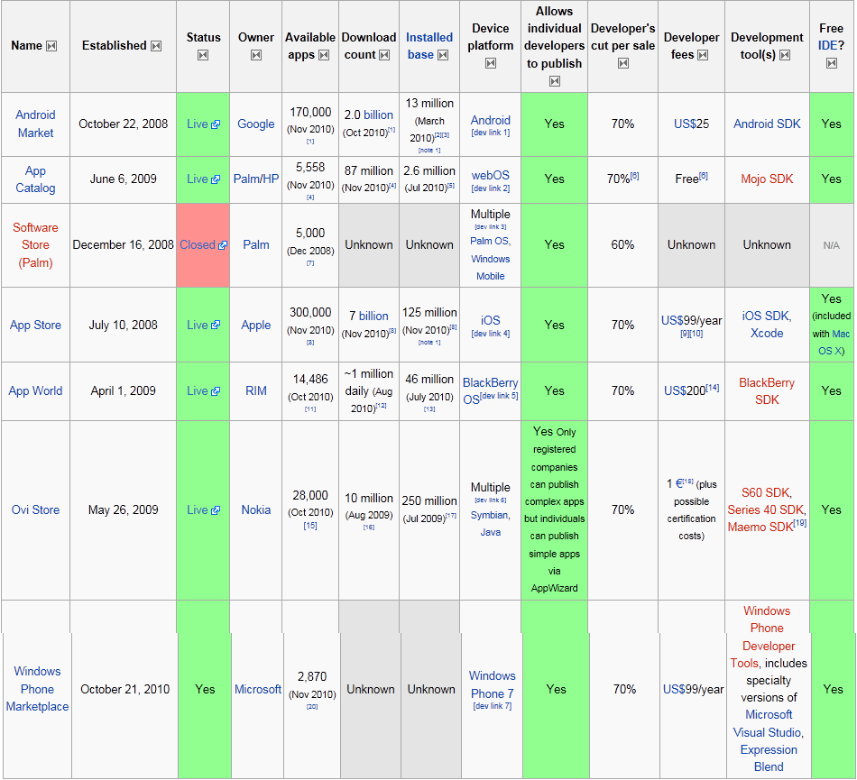
Native Mobile Applications
Feel more responsive
Developed in the platforms native SDK
Application Distribution
http://en.wikipedia.org/wiki/List_of_digital_distribution_platforms_for_mobile_devices
Proprietary and Confidential - © Blitz Digital Studios, LLC.

Slide 7
Native Applications
Minimal, if no Review Process (hours)
  Android Marketplace
Requiring Submission/Approval (days)
  Apple App Store
  BlackBerry App World
  Nokia Ovi Store
  Palm App Catalog
  Windows Marketplace
Proprietary and Confidential - © Blitz Digital Studios, LLC.

Slide 8
Native Applications
Development Languages
  Android
    Java / C/C++ (NDK)
    Adobe AIR
  Blackberry
    Java
    Adobe AIR
  iPhone
    Objective-C / C
    Flash iPhone Packager
Symbian
  C++
WebOS
  HTML 5 / Javascript / CSS
Windows Phone 7
  C# / Silverlight / XNA
Proprietary and Confidential - © Blitz Digital Studios, LLC.

Slide 9
Native Applications
Writing the same application for a different platform requires rewriting/porting most of the application logic
  Time consuming
  Costly
Proprietary and Confidential - © Blitz Digital Studios, LLC.

Slide 10
Web Applications
Built using HTML / CSS / Javascript
No App approval process
Depending on the mobile browser, can feel as responsive as Native Applications.
  HTML Offline Cache Manifests
  Local SQLite Database Storage
  jQuery based jQTouch UI Framework
    mimics iPhone UI
    http://www.jqtouch.com/
Proprietary and Confidential - © Blitz Digital Studios, LLC.

Slide 11
Web Applications
No Store based Monetization
Monetization is possible through user accounts
Write once deploy to any capable mobile web browser
  Not all web browsers are equal
  Not all screens are equal
  May require refinements based on User Agent detection (Browser Detection)
Proprietary and Confidential - © Blitz Digital Studios, LLC.

Slide 12
Games
(WebOS does not currently support 3D)
3D
  XNA
    Windows Phone 7
  OpenGL ES 1.1 (fixed function pipeline)
    iPhone 3G / 3GS
    Android < 2.x
    BlackBerry OS 5.0 or Greater
  OpenGL ES 2.0 (programmable pipeline)
    iPhone 3GS or Greater
    Android 2.x or Greater
Proprietary and Confidential - © Blitz Digital Studios, LLC.

Slide 13
Games
2D
  Android / BlackBerry / WebOS
    Platform Specific
  XNA / Silverlight
    Windows Phone 7
  Quartz / Core Animation
    iPhone
Proprietary and Confidential - © Blitz Digital Studios, LLC.

Slide 14
Flash Support
Platform | Supports Flash
Android | YES
BlackBerry | YES (OS 5.0 or Greater)
iPhone | NO
WebOS | YES
Windows Phone 7 | NO (Not Yet)
As of 2010-03-09
Proprietary and Confidential - © Blitz Digital Studios, LLC.

Slide 15
Major Technologies
Things BLITZ Knows
HTML (5) / CSS / Javascript
Flash Platform
  Actionscript 3
.NET Platform
  Microsoft Silverlight
iPhone OS Platform
  Objective-C
  Touch of C/C++
Things BLITZ Doesn’t Know
Java Platform
Android
BlackBerry
Full Blown C/C++
OpenGL ES 1.1 / 2.0
XNA
Quartz Programming
Unity
Proprietary and Confidential - © Blitz Digital Studios, LLC.

Slide 16
Major Technologies Breakdown
The Good News
We know what we know and we know it very well.
We have none or very little experience with the technologies we don’t know
The technologies we don’t know, especially OpenGL and XNA are capable of providing very rich experiences for our clients.
The Bad News
Proprietary and Confidential - © Blitz Digital Studios, LLC.

Slide 17
Information at the point of decision
Mobile technologies are with users wherever they may be.
Can provide users with more in-depth information based on public Call to Action Displays
Can provide users with information during purchase decisions
  Check the Web for Product Reviews
  Check the Web for Better Prices
Proprietary and Confidential - © Blitz Digital Studios, LLC.

Slide 18
Interaction in the real world
Chances are a mobile, connected, device is with a user wherever they go
Provides opportunity for new kinds of engagement
  Amazing Race Style Games / Scavenger Hunt
  Check-in Behavior - Four Square
  Social Media Updates - Twitter / Facebook
  Location Based Services
Proprietary and Confidential - © Blitz Digital Studios, LLC.

